Slide 1
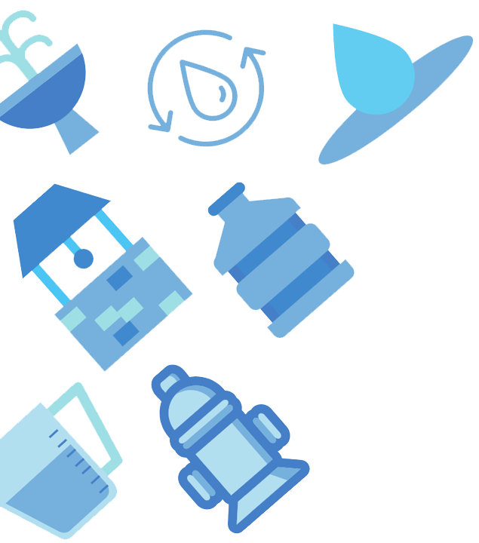
Redbud Field Trip
Activity Guide Part 2
Presented by Colorado River Alliance

Slide 2
Hello from CRA!
Colorado River Alliance is a small nonprofit dedicated to educating kids like YOU about our most precious resource—the Texas Colorado River!
Did you know that in Austin, 100% of your water comes from the Texas Colorado River? That’s right. Every time you turn on the faucet, take a shower, or flush the toilet, that water was originally pumped from the Texas Colorado River.
Watch this video to learn about Watersheds – what they are and why they’re important.
Use this vocab list as you go along and check off new words you learn!

Slide 3
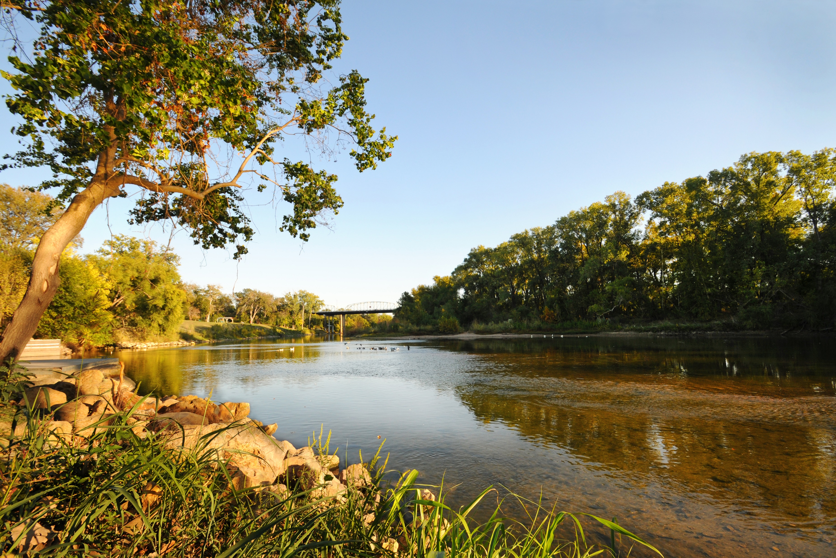
Texas Colorado River

Slide 4
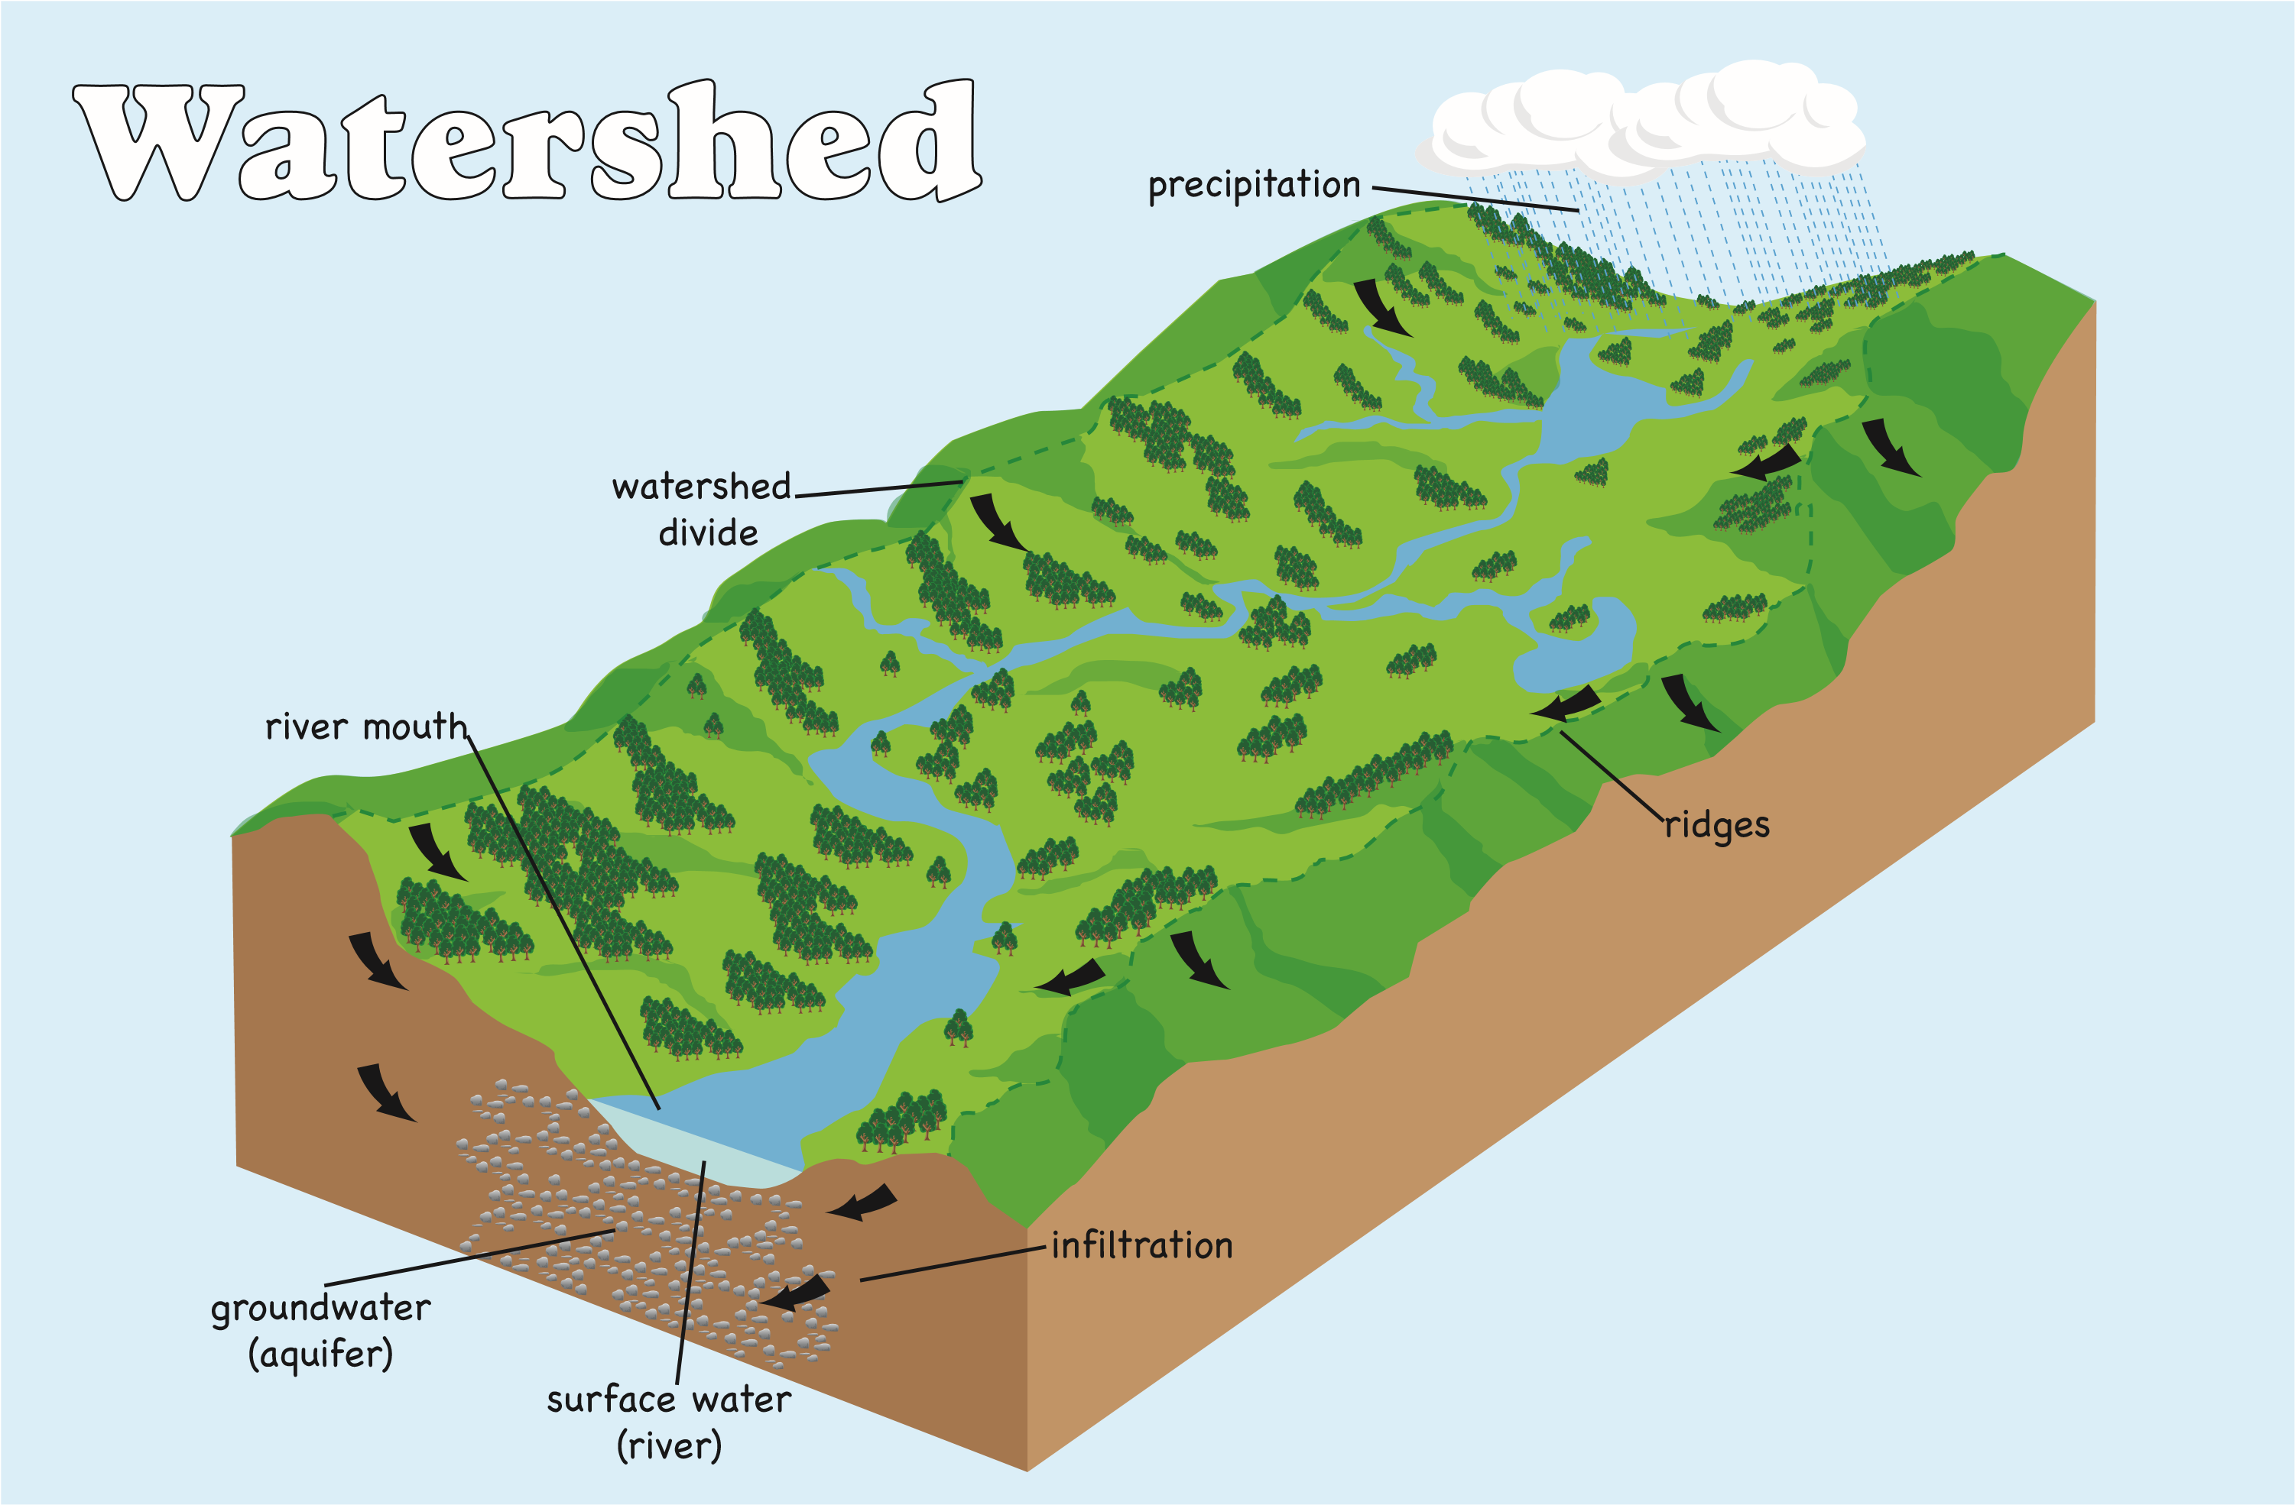
Everyone lives in a Watershed!
In the video, we learned that a watershed is an area of land that drains water into one location, like a lake or river.
The video also mentioned that it’s important to have a healthy watershed. What do you think a healthy watershed would look like?
Brainstorm THREE types of pollution that could impact a watershed:
___________________
___________________
___________________

Slide 5
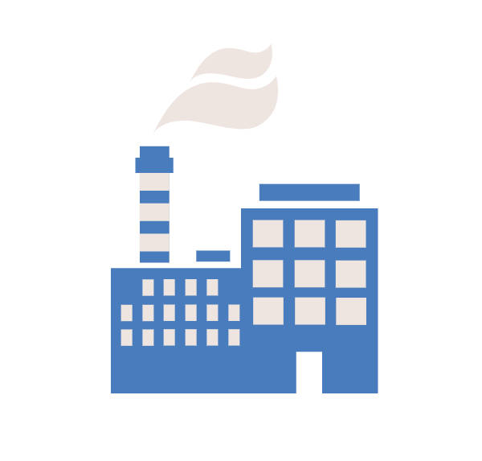
Pollution and Watersheds
Human activity affects the health of our watersheds.
Read the 6 situations on the next page(s), and answer the following questions for each situation:
What is the pollutant (substance that makes land, water, air, etc., dirty and not safe or suitable to use.) and why is it a problem?
What could the person(s) have done differently to protect the watershed?

Slide 6
Situation 1
Roger doesn’t take care of his car. His car leaks oil and other liquids everywhere he drives it. The oil leaks all over the streets.

Slide 7
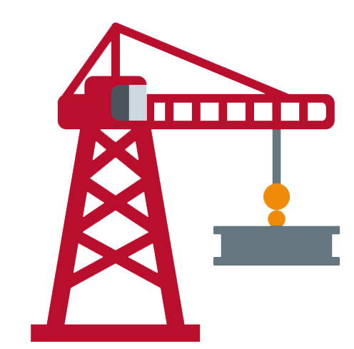
Situation 2
Clay has two loads of dirt dumped at the work site. He doesn’t block the surrounding storm drains to keep the dirt from running down the drains and into the nearby creek.

Slide 8
Situation 3
Peggy the painter just finished painting the gym at the middle school. She accidentally leaves a bucket of paint and a can of paint thinner on the curb outside. Later, some students find Peggy’s paint products and dump them into the street.

Slide 9
Situation 4
The neighbors on the street are competing with each other for the greenest and prettiest lawn. Mike spreads plant food (fertilizer), but he doesn’t read the instructions and uses way too much plant food.

Slide 10
Situation 5
Farmer Fred’s cattle feed lot is near the Barton Creek. Because he does not use a device to keep the rain runoff from entering straight into the creek, cow manure floats into the creek from the land.

Slide 11
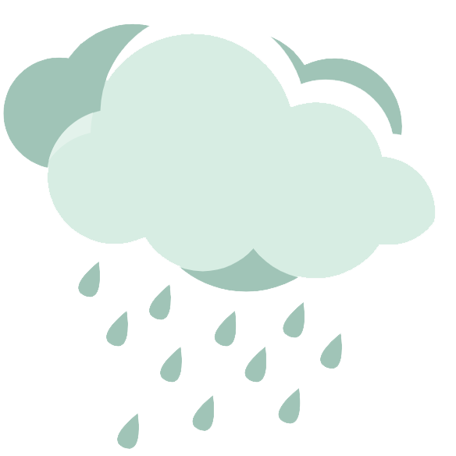
Situation 6
There is a festival at Zilker Park. 2,000 people attend and buy a lot of popcorn, sodas, and cotton candy. Thinking the city workers will pick up their trash, most folks just toss their wrappers and cans on the ground. That night a huge rainstorm comes through.

Slide 12
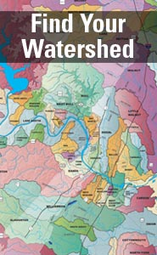
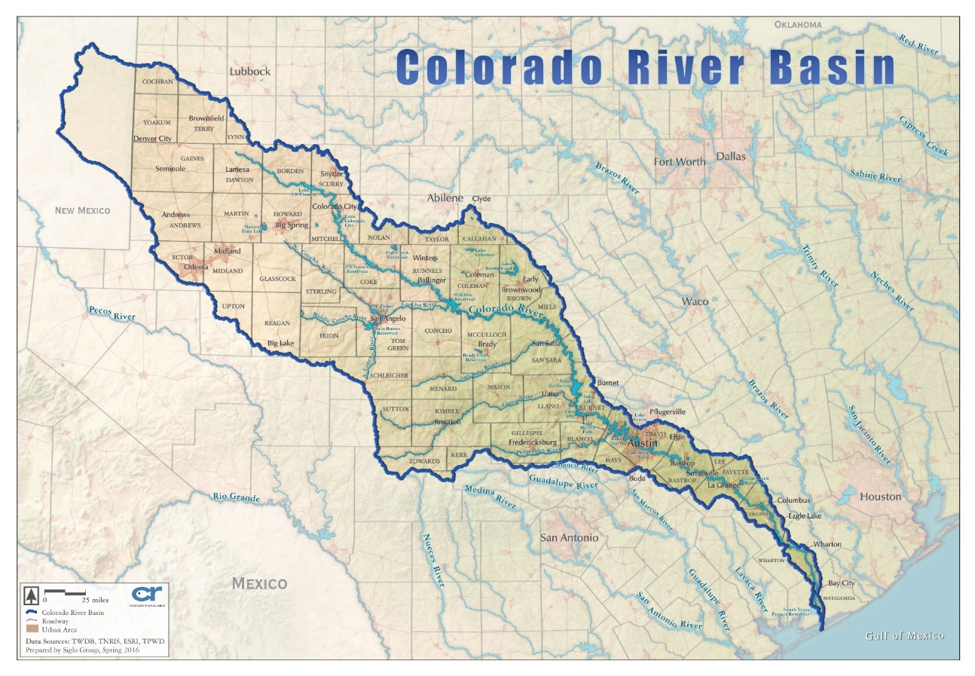
Find Your Watershed!
There are 53 watersheds in the city of Austin alone, each named after the body of water they flow into (ex: the Onion Creek Watershed collects water into Onion Creek)
You can be in more than one watershed at the same time. Because the 53 creeks in Austin eventually make their way to the Colorado River, the entire city is within the Colorado River Watershed—which makes up 16% of Texas!
Basin and Watershed mean the same thing!

Slide 13
Can you find Austin on the map?

Slide 14
Everyone Lives in a Watershed (cont.)
Let’s find out which watershed(s) you live in! Ask an adult to help you before using the internet.
If you live in Austin, go to…
https://www.atxwatersheds.com/findyourwatershed/
Click the in the upper right-hand corner and type in your address. Then click “Details” to see how healthy your watershed is.
If you live outside of Austin, go to…
Texas Watershed Viewer
Type in your address, then click anywhere on the map to see the name of your watershed.

